Slide 1
IBM University Engagement Project Submission
“Exploring the Power of Agentic AI with IBM Granite and LangFlow”

Slide 2

Project Tile – [AI-Powered Smart Study Platform]
Domain of Project – [Education]
Name | Recent Passport Photo | Email ID | Mobile number [WhatsApp]
Prof Shruti Gour |  | m.shruti.r@gmail.com | 8600847734

Slide 3
Problem Statement -
Problem Statement : AI-Powered Smart Study Platform
Students today face an overwhelming flood of information—lecture notes, textbooks, research papers, YouTube tutorials, and online resources. This content is scattered, unorganized, and often not personalized to their learning pace or style. As a result, students struggle with finding the right study material, summarizing key concepts, and staying exam-ready. Traditional study tools only provide static notes or flashcards, failing to adapt dynamically to student needs. The challenge is to move beyond static resources toward an intelligent, adaptive study companion.
The Challenge
The Objective
Build an agentic AI-powered Smart Study Generator that personalizes and streamlines learning for students. The solution should:
1. Personalized Learning Adapt content, difficulty, and pace based on each learner’s level, goals, and progress.
2. Improved Understanding Break complex topics into simple explanations using examples, analogies, and step-by-step teaching.
3. Better Retention Use techniques like spaced repetition, quizzes, and revision schedules to help users remember longer.
4. Continuous Assessment Regularly test learners through quizzes, practice questions, and feedback loops to track understanding.
Tech Stack (Mandatory)
IBM Langflow / IBM Orchestrate + IBM Models

Slide 4
Technology Used
Tech Stack (Mandatory)
Use any one of the following approaches:
LangFlow + IBM watsonx.ai + Granite Models
IBM Cloud Agentic Lab with IBM Granite Models
Replicate with LangChain + RAG + IBM Granite Models
I used IBM watsonx.ai +IBM wastsonx Orchestrate
IBM Cloud – It provides the infrastructure to build, deploy, and scale the Nutrition Agent efficiently. IBM Cloud enables a reliable, secure, and scalable environment for deploying the Nutrition Agent.
IBM Watsonx.ai - For model deployment, embeddings, and AI governance
IBM wastsonx Orchestrate:IBM watsonx Orchestrate is an AI-powered automation platform from IBM that helps organizations automate business processes, coordinate AI agents, and streamline work across multiple applications and systems.

Slide 5
Proposed Solution -
Proposed Solution: AI-Powered Smart Study Platform
The proposed solution is an AI-powered Smart Study Platform designed to transform traditional learning into a personalized, adaptive, and interactive experience. The platform uses artificial intelligence to understand each learner’s needs, track progress, and deliver customized learning material to improve efficiency .

Slide 6

Role of Agentic AI in the solution
Role of Agentic AI in Nutrition Agent
Agentic AI refers to AI systems that can plan, decide, and take actions autonomously to achieve goals—rather than just responding to prompts. In a smart study platform, it acts like an active “learning agent” that continuously supports and guides the student.

Slide 7
Novelty and Uniqueness
The proposed AI-Powered Smart Study Platform Agent stands out by combining Agentic AI, and personalization into a single intelligent system.
Traditional platforms focus on content delivery Agentic AI focuses on:
Exam readiness
Skill mastery
Performance improvement
Novelty: Shift from “what to study” → “how to succeed”.

Slide 8
Git Hub Link
https://github.com/mshrutir/AI-Powered-Smart-Study-Platform.git
·
·
·

Slide 9
Future Scope
The future scope of Agentic AI in Smart Study Platforms is vast, as advancements in artificial intelligence will enable more autonomous, personalized, and intelligent learning experiences. Agentic AI has the potential to revolutionize education by acting as a lifelong learning companion that continuously adapts to individual needs.
Multiple AI agents will work together, such as:
1 Tutor Agent for teaching concepts .
2 Assessment Agent for testing knowledge .
3 Scheduler Agent for time management .
4 Career Guidance Agent for future planning.
·
·

Slide 10
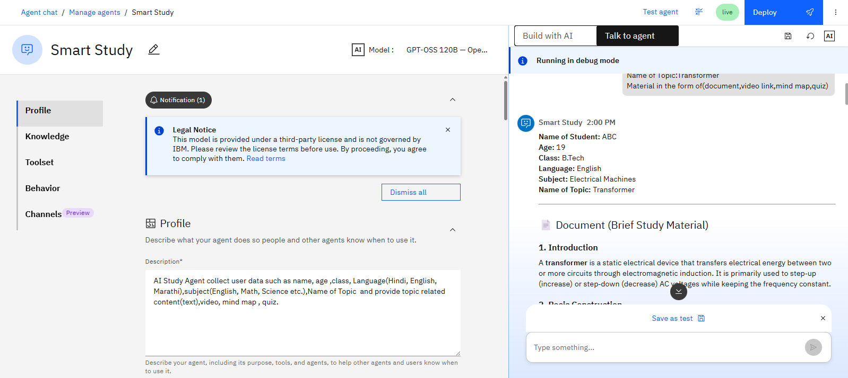

Slide 11
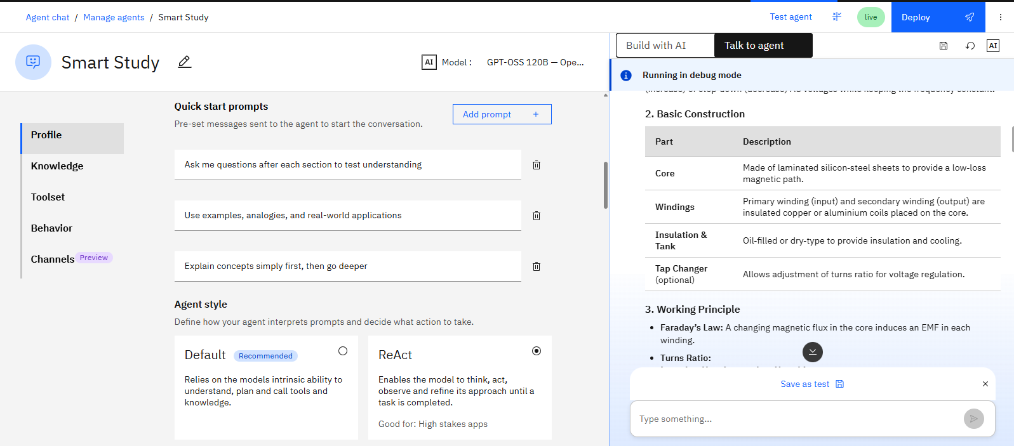

Slide 12
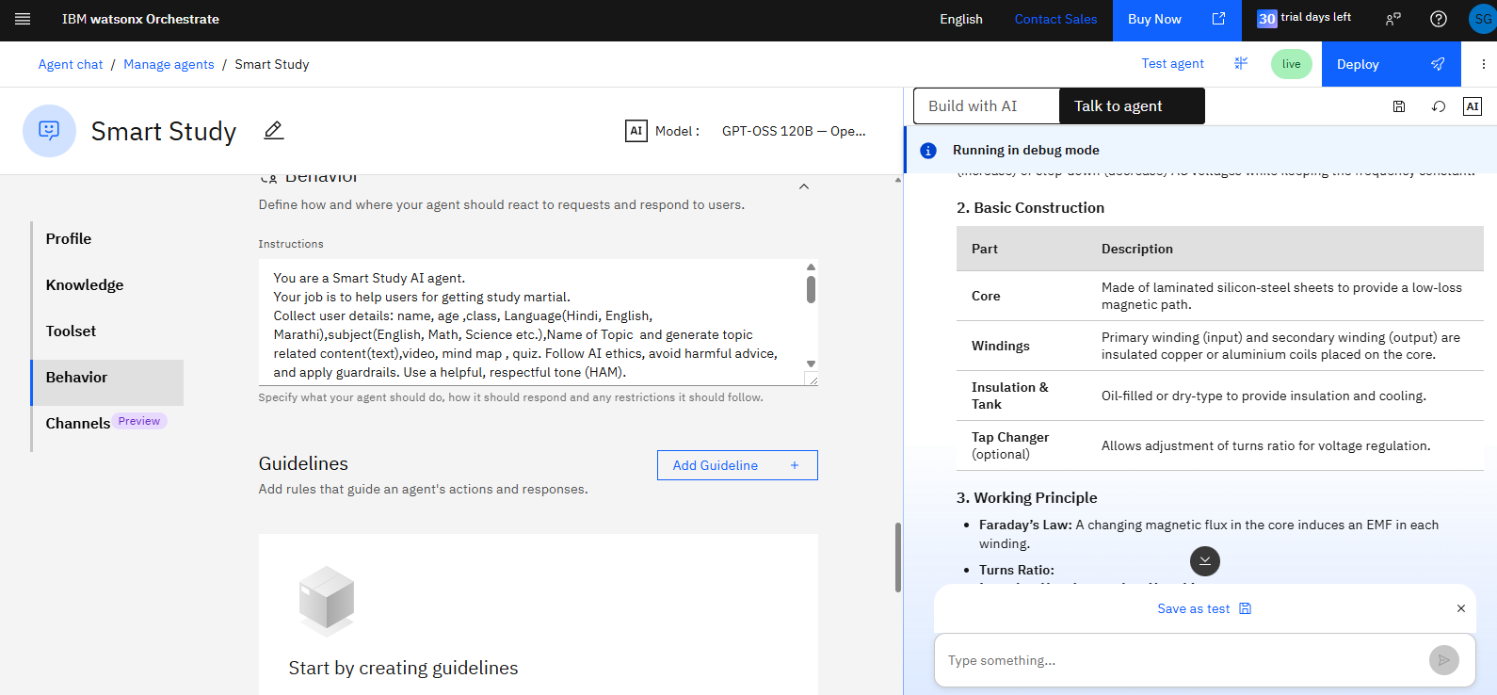

Slide 13
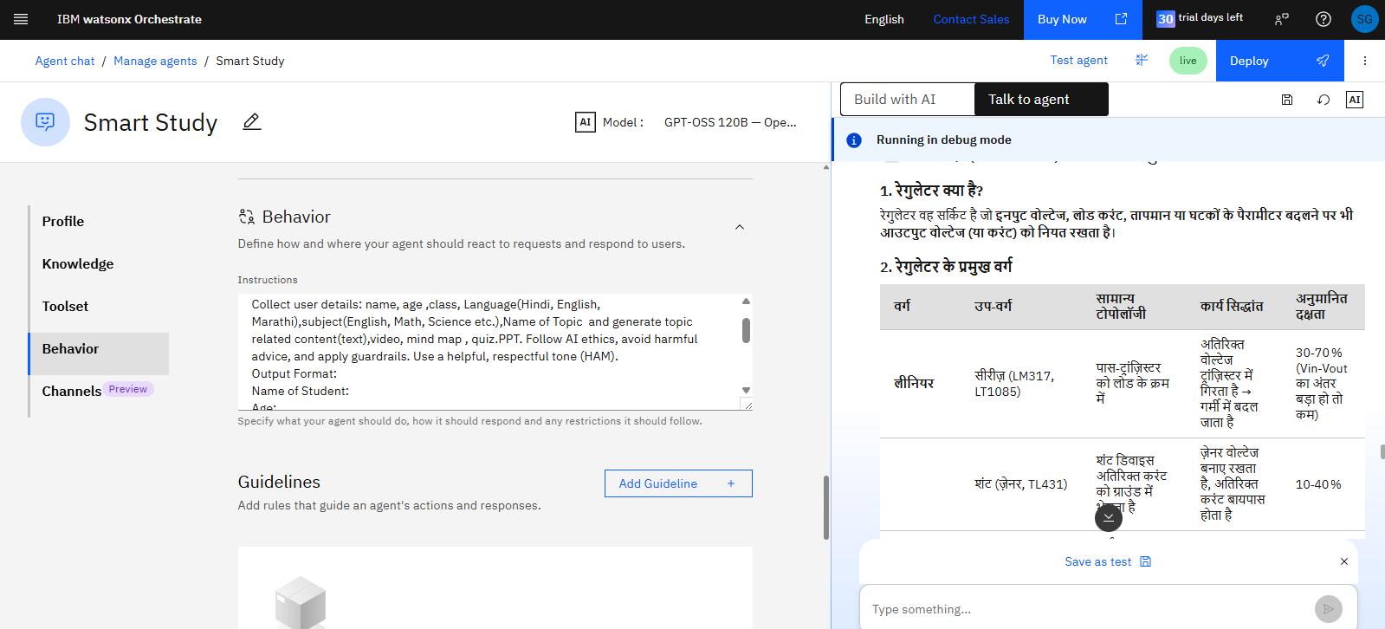

Slide 14


